Slide 1
Ecosystem modelling: Representing Mass Balance using Ecopath
Northeast Fisheries Science Center
Sean Lucey
February 19, 2016

Slide 2
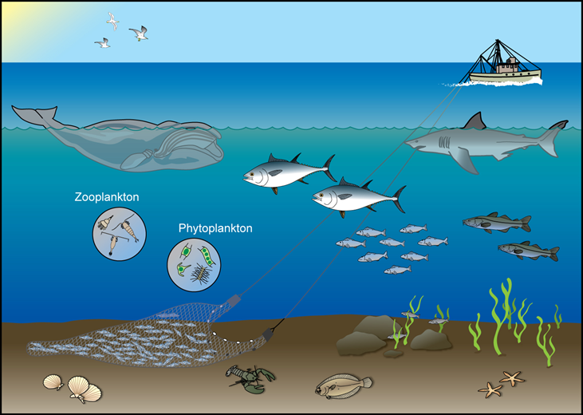
Role of Ecosystem models
Provide context and understanding
Mostly strategic advice
Limited tactical advice
Complement not replace single-species models
Notes:
Impact of target species, effects of top predators, competition between fisheries and predators
Impacts of biodiversity, non-retained bycatch, physical/environmental factors

Slide 3
Types of models (Plaganyi 2007)
Extensions of Single-Species Assessment Models (ESAM)
Dynamic System Models (Biophysical)
Minimum Realistic Models (MRM)
Whole Ecosystem Models

Slide 4
Plaganyi 2007
Biological interactions described
No
Technical interaction models MSYPR
Murawski 1984
Yes
No
Predators added to single-species models e.g. SEASTAR
Gulland 1983; Livingston and Methot 1998; Hollowed et al. 2000; Plagányi 2004; Tjelmeland and Lindstrøm 2005
Predator prey feedback
Yes
No
Handles the environment and lower trophic levels
Yes
Handles age/size structure
Yes
Handles age structure
No
Yes
No
Handles spatial structure
Handles spatial structure
Multispecies Production Models e.g. Horbowy 2005
No
Yes
No
Yes
Aggregate system models e.g. EwE, SKEBUB, SSEM
Spatial dynamic systems models e.g. ATLANTIS, ERSEM, SEAPODYM
Dynamic multi-species models BORMICON, GADGET, MRMs, MSVPA& MSFOR, MSM, MULTSPEC, OSMOSE
Dynamic systems models e.g. some recent EwE applications
Spatial aggregate systems models e.g. ECOSPACE

Slide 5
Plaganyi 2007
30 +
20
10
5
3
2
ATLANTIS
EwE
NO. OF SPECIES / COMPONENTS
ERSEM, INVITRO, OSMOSE
GADGET
BORMICON, MSVPA, MULTSPEC,
ESAM, MRM, SEASTAR, Bioener -getic type
MSM, SEAPODYM

Slide 6
Plaganyi 2007
Marine mammals, sharks etc
TROPHIC LEVEL
MRM, MSVPA, GADGET, SEASTAR, SEAPODYM, IBM, MSM, Bioenergetic
EwE, ATLANTIS, INVITRO
OSMOSE
Clupeoids, demersals etc
Zooplankton, filter-feeders
ERSEM SSEM
Phytoplankton, detritus
External forcing

Slide 7
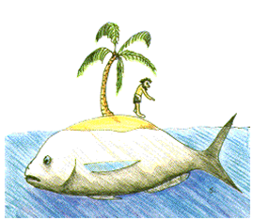
Ecopath with Ecosim
Ecopath - Food web modeling framework developed by Polovina (1984) and refined by Christensen and Pauly (1992)
Ecosim – Dynamic simulation developed by Walters et al. (1997)
Ecospace – Spatial dynamic simulations developed by Walters et al. (1999)

Slide 8
Highlights
> 400 publications
Top 10 scientific break through by NOAA
30th Anniversary International Symposium
Used sparingly in management
North Sea model – WGSAM
Alaska
Western Scotian Shelf

Slide 9
Best use
Identify and quantify major energy flows in the ecosystem
Describe ecosystem resources and their interactions
Evaluate the ecosystem effects of fishing or environmental changes
Explore management policy option
Plaganyi 2007

Slide 10

Ecopath
Snapshot of the ecosystem state
Trophic model
Mass balance
Not necessarily steady-state
Time-invariant
www.hamidslimi.com

Slide 11
Before you begin: Define your boxes
Consider what question you are asking
Use functional ecological groupings with niche overlap rather than taxonomy to aggregate
Leaving out a group because of poor data is worse than guessing
Include all trophic levels
Careful with bacteria
Must have at least one detrital group

Slide 12

More on boxes
Be sure to include top predators
Consider age-specific stanzas that capture ontogenetic shifts in diet or exploitation patterns
Used in Ecosim
science-facts.top5.com

Slide 13

Model time frame
Models typically use average values for the year
Seasonal changes are not incorporated
Important to note large scale changes in ecosystem structure

Slide 14
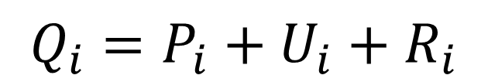
Mass Balance Master Equations
Production = predation + fishery + biomass accumulation + net migration + other mortality
Consumption = production + unassimilated food +
respiration
$$P_{i}={M2}_{i}B_{i}+Y_{i}+{BA}_{i}+E_{i}+{M0}_{i}B_{i}$$
$$Q_{i}=P_{i}+U_{i}+R_{i}$$

Slide 15
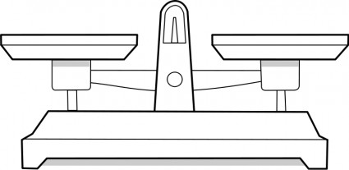

Slide 16
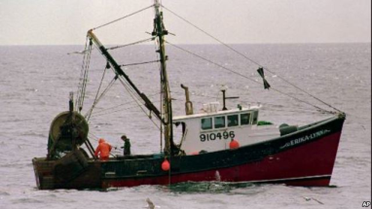
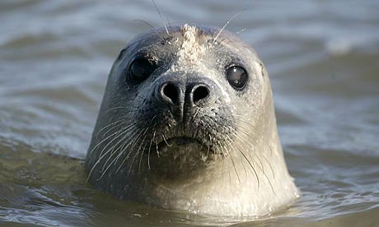
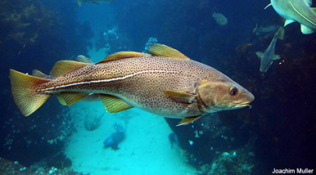
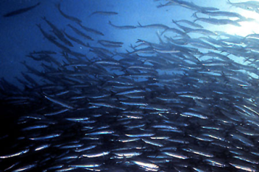
www.voanews.com
www.theguardian.com
www.gma.org

Slide 17

What you need: Data requirements
Biomass (B)
t km⁻²
Production to Biomass (PB)
year⁻¹
Consumption to Biomass (QB)
year⁻¹
Ecotrophic Efficiency (EE)
proportion
Diet Composition (DC)
proportion
Catch (landings/discards)
t km⁻² year⁻¹

Slide 18
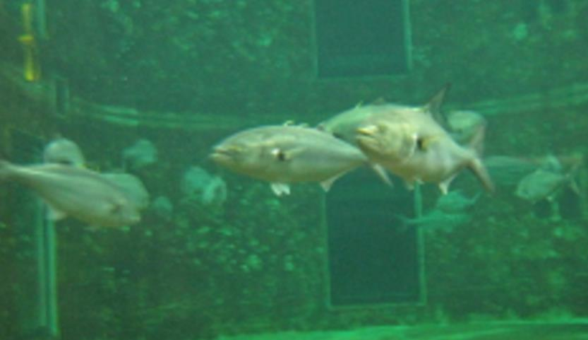
Biomass (B)
Obtained from standard assessment methodologies
Important to use local information (scale of model)

Slide 19
Production to Biomass Ratio (PB)
Production = mortality + ∆B
Estimate of total mortality (Z)
PB = Z = F + M
Can calculate F from estimates of biomass and catch (F = C/B)
Get M from assessments or other tools
FishBase
Pauly’s (1980) empirical natural mortality equation
Also calculate Z directly using Beverton-Holt (1957) equation

Slide 20
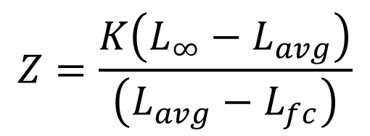
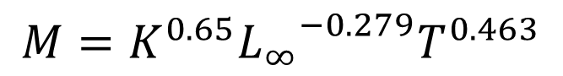
Pauly (1980)
Beverton-Holt (1957)
$$M=K^{0.65}{L_{∞}}^{−0.279}T^{0.463}$$
$$Z=\frac{K\left(L_{∞}−L_{avg}\right)}{\left(L_{avg}−L_{fc}\right)}$$

Slide 21
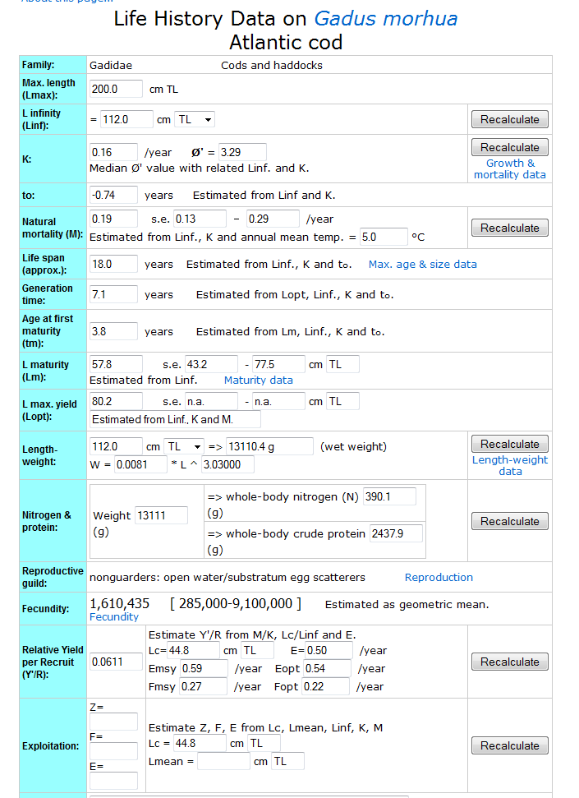
FishBase.org

Slide 22

More on PB
Good rule of thumb
reciprocal of PB ≈ mean life span
Unless growth is linear (primary producers) then the reciprocal ≈ mean age
Example
Whale – PB = 0.03 year⁻¹, BP = 33 years
Herring – PB = 0.4 year⁻¹, BP = 2.5 years

Slide 23
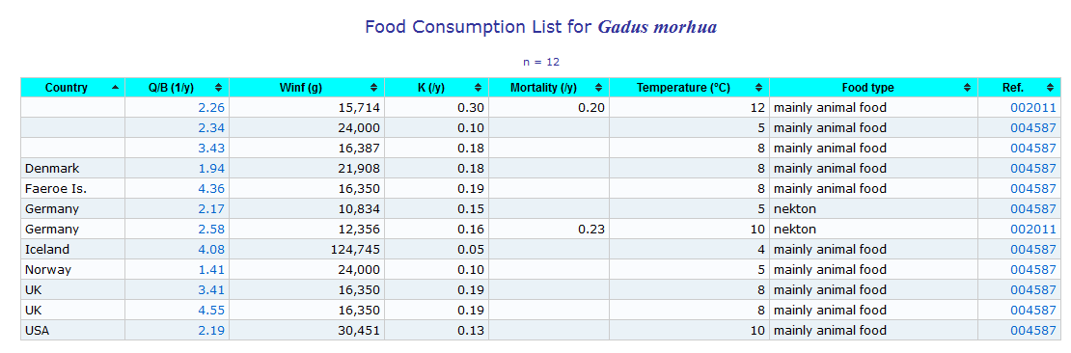
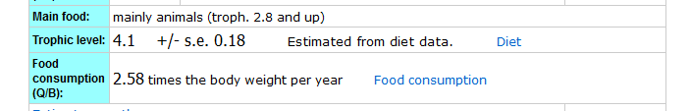
Consumption to Biomass (QB)
Primarily from literature values (FishBase)
Varies with PB therefore it can be calculated using a PQ ratio

Slide 24

Production to Consumption Ratio (PQ)
Typically varies between 0.05 and 0.30
Lower for baleens and higher for very small organisms
Smaller individuals generally more efficient (higher PQ)
If PQ entered then PB or QB is calculated
kidsaquariumsquotes.wordpress.com

Slide 25
Ecotrophic Efficiency (EE)
Defined by Ricker (1969) as the fraction of a prey species’ annual production that is consumed by predators
Basically proportion of production explained in the system
Other mortality is 1 – EE
Typically close to 1
Unexploited top predators close to 0
Phytoplankton in bloom closer to 0.5

Slide 26
Diet Composition (DC)
Use proportions by either weight or volume
May need to aggregate/ disaggregate data based on box structure
Often necessary to tweak DC to ensure mass-balance

Slide 27
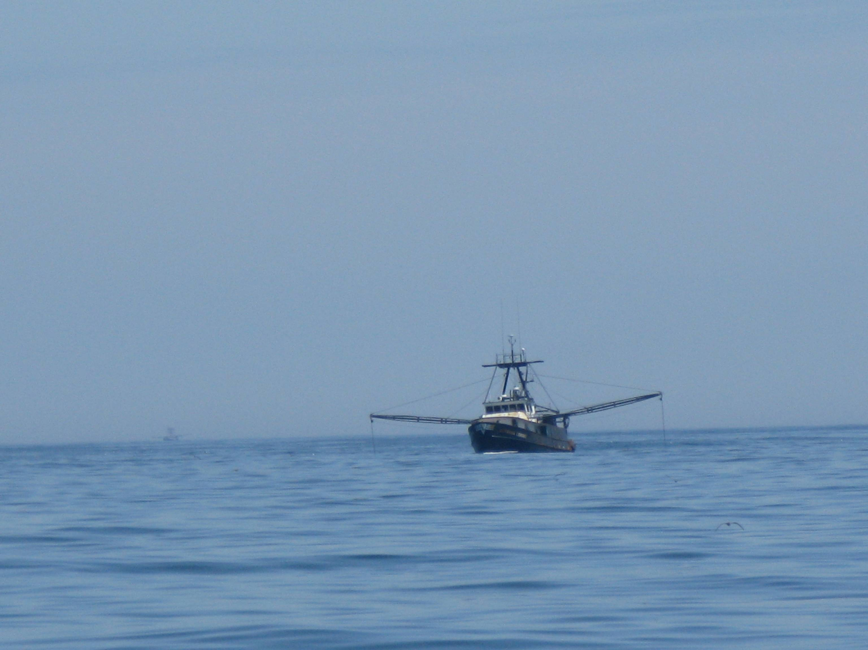
Catches
Include any number of fleets/gears
Possible to include economic variables
Advisable to create a ‘discards’ detrital group
Discards assigned to it via discard fate

Slide 28
Other parameters
Biomass accumulation (BA) – t km⁻² year⁻¹
If data shows change in B over model domain
Migration (E) - t km⁻² year⁻¹
Can be used by Ecospace
Detritus fate
All living groups produce detritus – U and M0
Necessary to specify where it is going if more than one

Slide 29

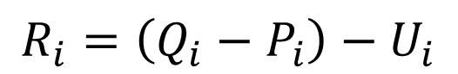
Respiration (R) and Unassimilated food (U)
Rearrange consumption equation
Q and P are estimated first
U is input parameter than effects R
Default value for U is 0.2
Herbivores and Detritivores ~ 0.4 leads to more reasonable R/B ratios
$$R_{i}=\left(Q_{i}−P_{i}\right)−U_{i}$$
tcmmg.org

Slide 30
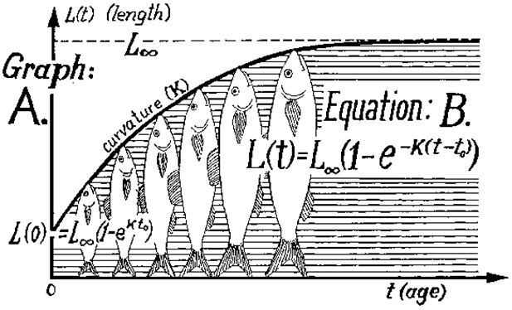
Multi-stanza groups
More important for Ecosim
Additional parameters
Length of stanzas (months)
Z per stanza
Von Bertalanffy K
Relative weight at maturity (W_{mat}/W_{inf})

Slide 31
From Parameters to Mass Balance
Can’t possibly have estimates for all parameters
Set of linear equations
Number of unknowns less than the number of equations
Order Ecopath solves things
QB
PB
EE
B
Can not estimate DC

Slide 32
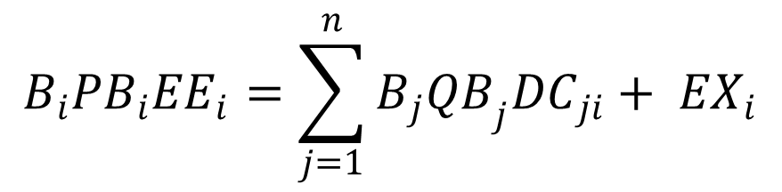
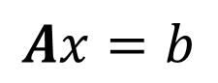
Solving unknowns
Rearrange the production master equation
$$P_{i}={M2}_{i}B_{i}+Y_{i}+{BA}_{i}+E_{i}+{M0}_{i}B_{i}$$
$$B_{i}{PB}_{i}{EE}_{i}=\sum_{j=1}^{n}{B_{j}{QB}_{j}{DC}_{ji}}+ {EX}_{i}$$
$$Ax=b$$

Slide 33

Mass Balance
Solve series of equations
Typically several EE > 1 (Not physically possible)
Tweak input parameters

Slide 34
Keys to fixing unbalanced models
Explore the mortalities on problem species
Fishing
Predation
Identify big problems initially
Change most uncertain parameters first

Slide 35
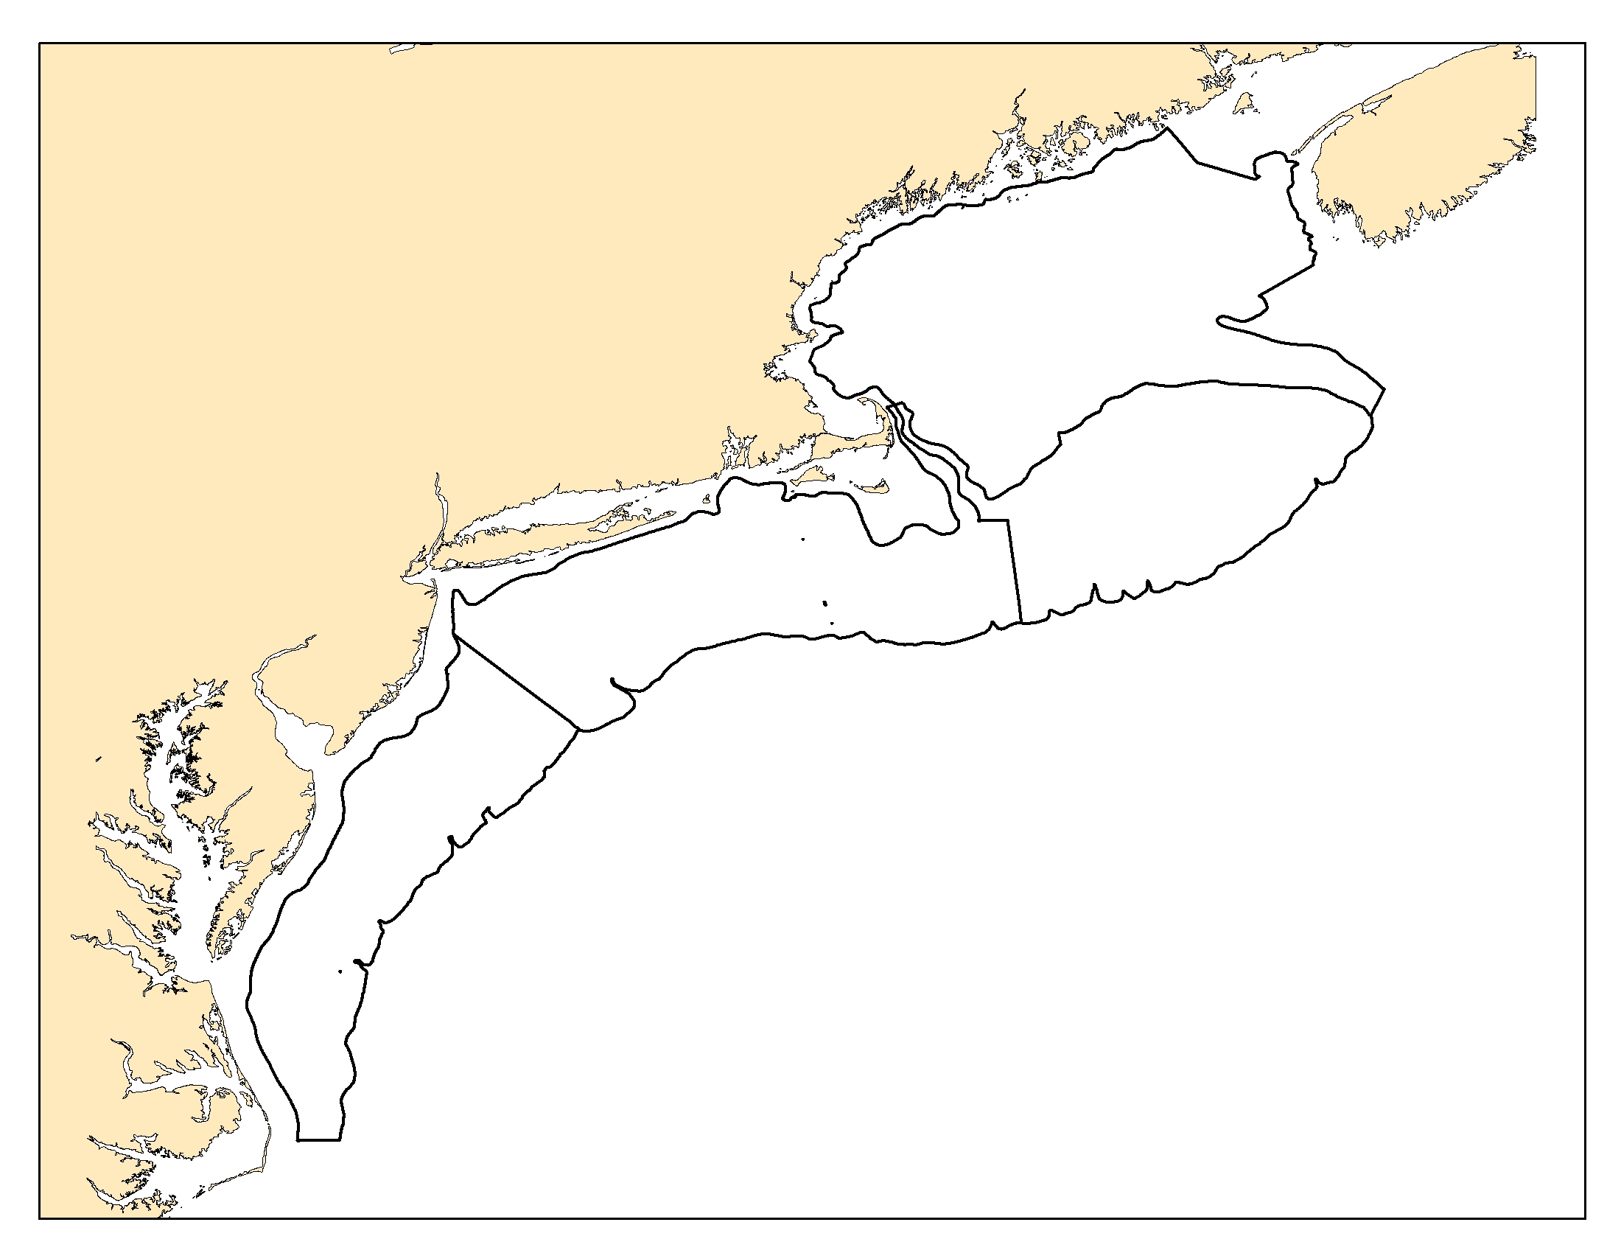
Mass Balance at the NEFSC
Energy Modeling and Analysis exercise (EMAX)
Ecopath
EcoNetwrk
Broken into 4 “eco-regions”
Highly aggregated

Slide 36
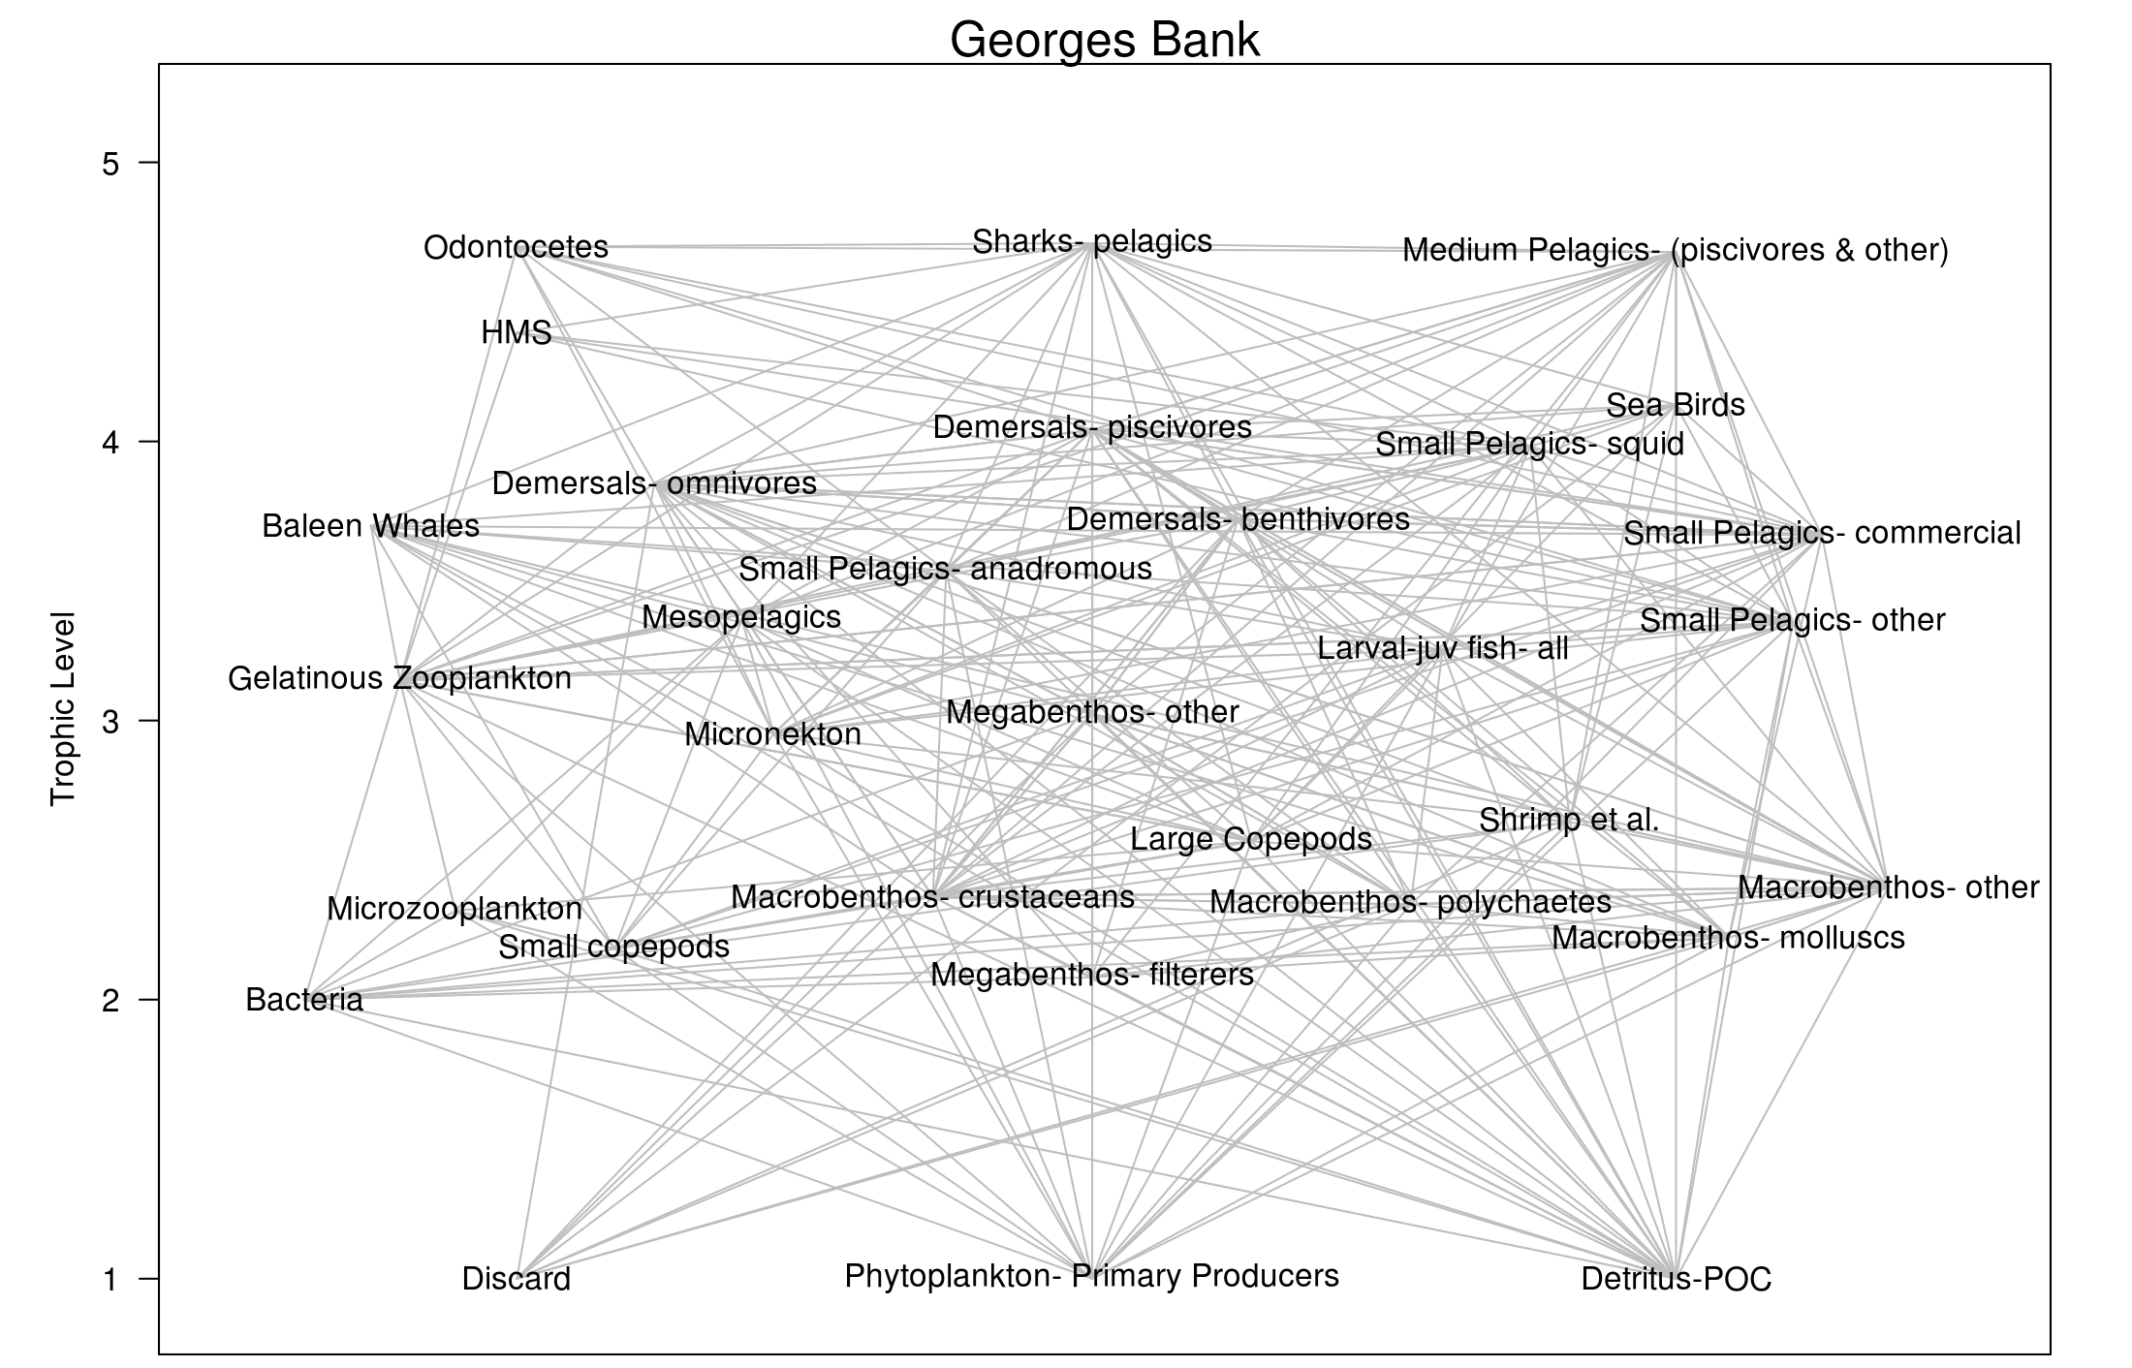

Slide 37
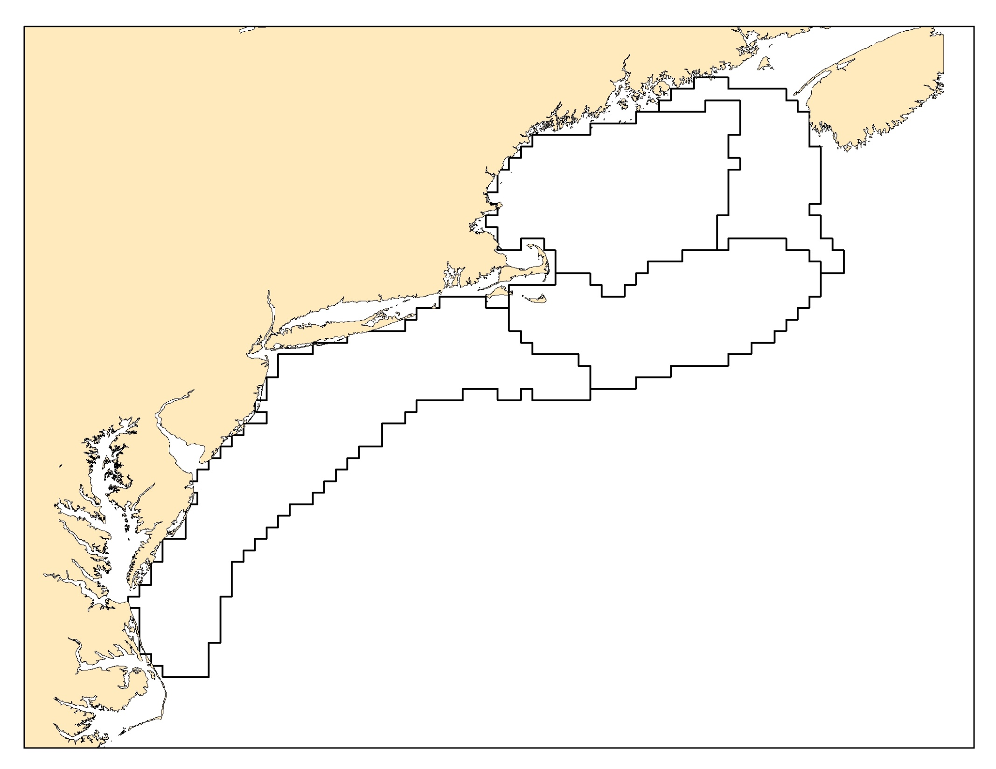
Next generation…
Based on ecological production units
More individual species
All commercial species
Some with Adult/juvenile groups
Allow biomass to flow between models

Slide 38

Quick Ecopath with Ecosim Demo
Free software available at ecopath.org
Windows specific
User friendly GUI

Slide 39


Rpath – R implementation of EwE
Compliment and expand the open source possibilities of Ecopath with Ecosim
Use a platform widely used by ecologists, R
Utilize the built-in statistical and graphical capabilities of R

Slide 40
Advantages | Disadvantages
Greater flexibility/customization | No GUI interface
Leverage existing R packages | Knowledge of R required
Community development
Cross-platform software
Reproducibility

Slide 41
Lab
Build Anchovy Bay test model in Rpath
Try and fix several unbalanced models

Slide 42
